Slide 1
About R.K Narayan
A HERO

Slide 2
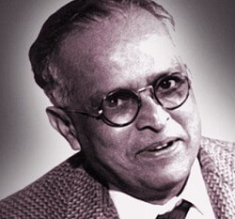

Slide 5
The story is about Swami who becomes an accidental hero and pride of his family. As a young boy, Swami dislikes going to school or work hard at anything. He likes to spend time with his friends and hear stories from his grandmother. He is pampered by his grandmother and so he only sleeps by her side.
However, this situation disturbs Swami’s father who wants to discipline Swami and wants him to become independent and self-reliant. He read stories of great feats by young children and wants his son to be one of them.

Slide 6
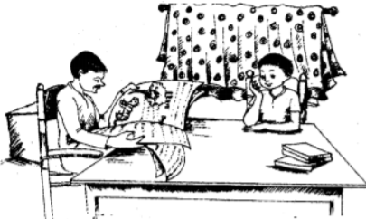
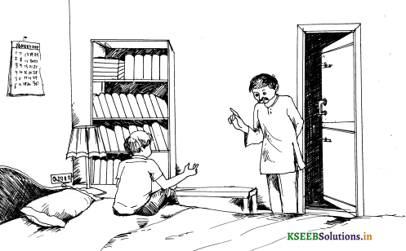
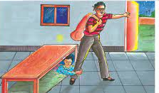

Slide 7
https://www.youtube.com/watch?v=BkWiwELoLkc&pp=ygUOYSBoZXJvIGdyYWRlIDc%3D

Slide 8
1] The boy who fought the tiger stayed on the tree for half-a-day because he
a] wanted to watch the tiger from the top.
b] wanted to rest for some time.
c] was waiting for help.
d] did not like the tiger
2] Swami’s father asked him to sleep alone in the office room as he ..
a] wanted him to catch burglar.
b] wanted him to prove that he had courage.
c] wanted him to look after the office.
d] wanted him to prove that he had strength.
3] “Aiyo! Something has bitten me.” The something was
a] a scorpion
b] a tiger
c] a devil
d] Swami

Slide 9
4] A burglar is a person who……..
a] enters a house to steal
b] kills a tiger
c] writes for newspaper
d] bites other people
5] Swami decided to sleep under the bench because………….
a] he felt it was a safe place
b] it was near the door
c] it was not dust
d] it was made of wood
6] For Swami events took an unexpected turn because …………. a] his father was angry with him.
b] his father read about a newspaper report.
c] his home work was not doned] his exams were near

Slide 10
Reading 2
Home Fun

